Slide 1
Scaling Organizations Using Kubernetes
Richard Fliam, Lead Engineering Effectiveness, Comcast VIPER

Slide 2

Hi

Slide 3
Comcast VIPER, 7 Years Ago

Slide 4
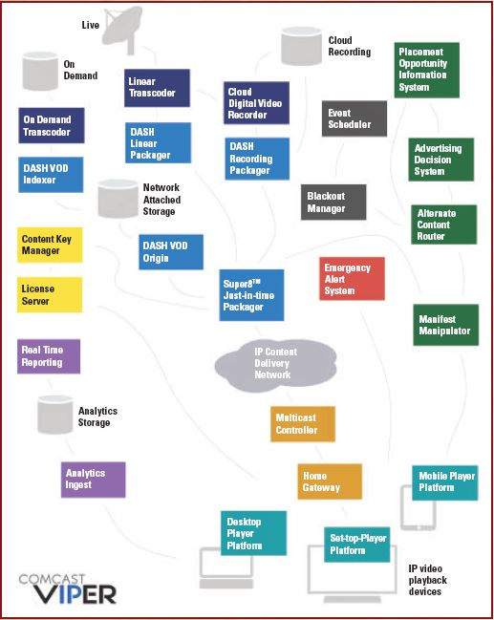
Comcast VIPER, Today

Slide 5

growing organizations is hard

Slide 6
Five Engineers
One Product
One Site
VM Images

Slide 7
Fifteen Engineers
Ops Team
Multi Site

Slide 8
Fifty Engineers
Multi-Service
Multi-Site
Puppet

Slide 9
One Hundred Engineers
QA Teams
Project Management

Slide 10
Two Hundred Engineers
SaaS Customers
Pain

Slide 11
Why is 200 Slower and Less Effective (per person) Than 20?
N x N Communications
Organizational Bottlenecks
Organizational Coupling

Slide 12
N x N Communications

Slide 14
Communication becomes the rate limiter on our ability to change

Slide 15
Shared organizational resources
always
become overloaded

Slide 17
Organizational coupling prevents us from taking effective independent action

Slide 18
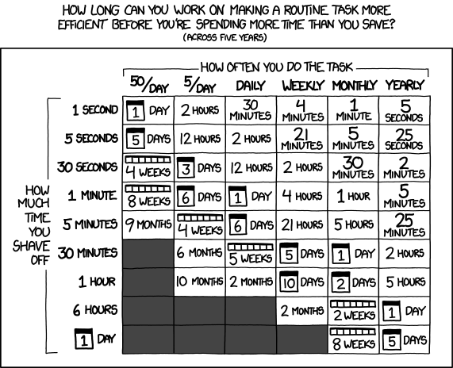
xkcd on Point as Always

Slide 19
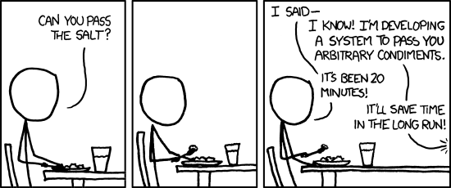
xkcd on DevOps

Slide 20
Let’s operate hundreds of microservices, thousands of machines, databases, objectstores and more
with puppet
Said no one ever

Slide 21
Scaling ourselves isn’t about doing more work
It’s about having a bigger effect

Slide 22
Increase our
freedom of action
and its
effect

Slide 23
Kubernetes: Container Orchestration

Slide 24
Kubernetes: Container Orchestration Datacenter OS

Slide 25
Your desktop OS needs sysctl, ps, top, iostat, journalctl, and user management
So does your datacenter OS

Slide 26
How do I manage software deployment and packaging?
rpm and
yum (dnf)
(or pkg and apt-get you Debian traitors)

Slide 27
Let’s write those for Kube and call it:
Geronimo and
Taklishim

Slide 28
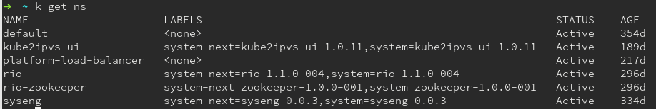
RPM for Kube = Geronimo

Slide 29
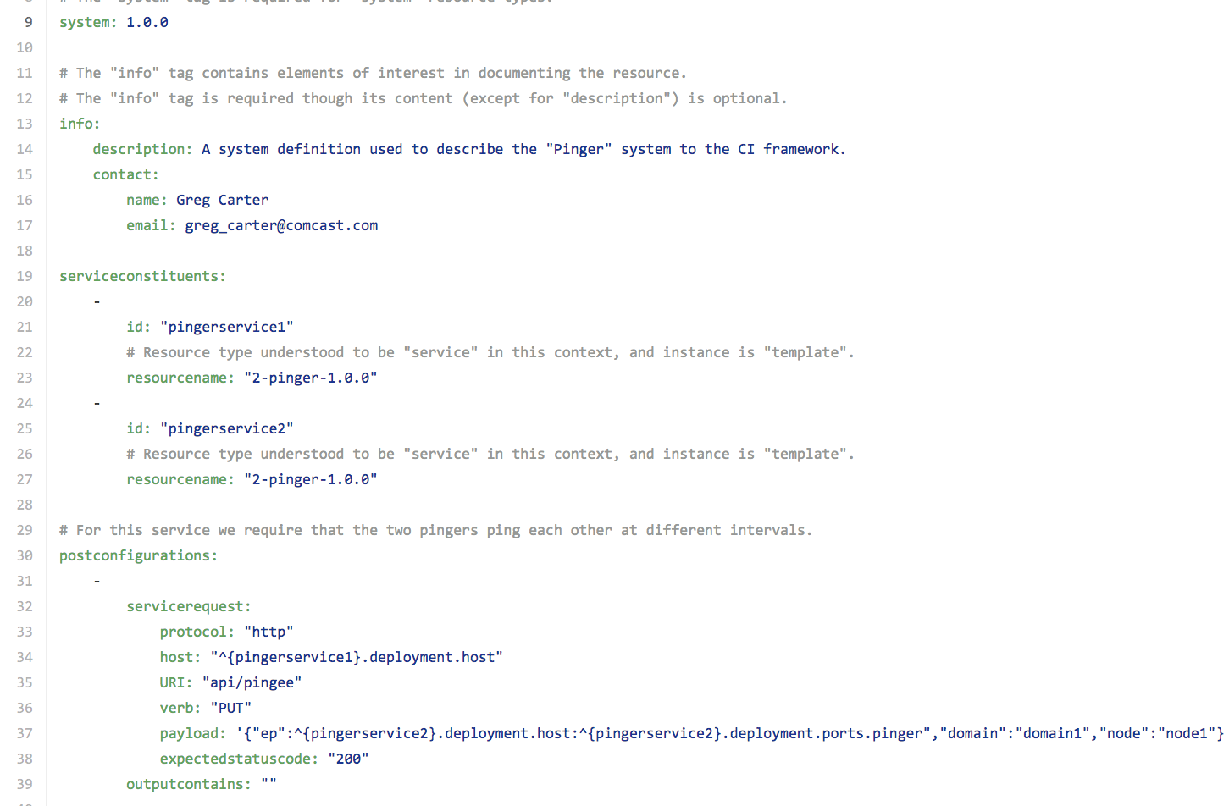
Yum for Kube = Taklishim

Slide 30
Changes, deployments, and versions of the system are
communicated as code
automatically

Slide 31
Which means I can reliably automate testing and deployment at scale

Slide 32
Underlying infrastructure can be changed independent of the applications

Slide 33
Which is Less Complicated?

Slide 34
Scale ourselves by enabling
large, effective, safe
changes with
freedom and comfort

Slide 35
I <3 Kube

Slide 36
Bye (questions?)

